Slide 1
MINAT: Lecture6 -Microscopy
Jessica de Wild (Jessica.dewild@uhassselt.be)

Slide 2
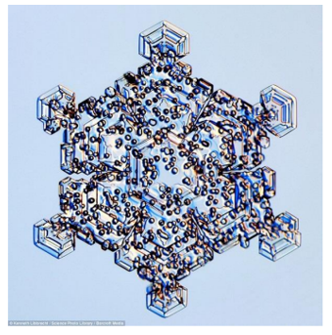
Microscopy
Microscopy ➔ Mikros (small) + Skopion (to see) Microscope ➔ See small things

Slide 3
Basic of optics
Convex lens
-parallel light beams converge after lens
-focal point after lens
Concave lens:
-parallel light beam diverge after lens
-focal point before the lens

Slide 4
Image formation
S1 – object length
S2 – image length
f – focal point
S1 > S2:
image size decrease
S1 < S2: magnification
Notes:
Object afstand, beeld afstand. Beel heeft andere grootte dan origineel. Al s je het obect voor het focal punt plaats, krijg je een vergroting.

Slide 5
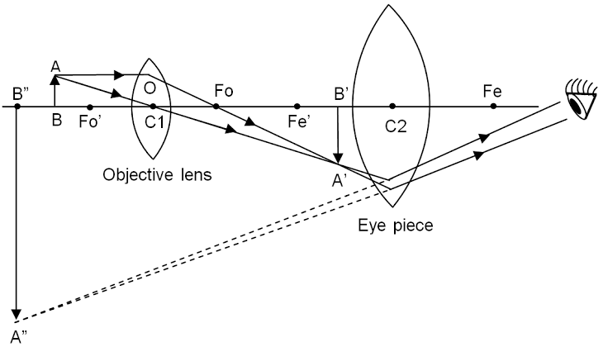
Simple optical microscope
Objective lens: collecting the light and focus before eye peace
Eye peace: focusing light on the eye
A’’-B” magnified image
Notes:
Objectief: collecteert het licht, eye peace lens: focused weer op het oog

Slide 6
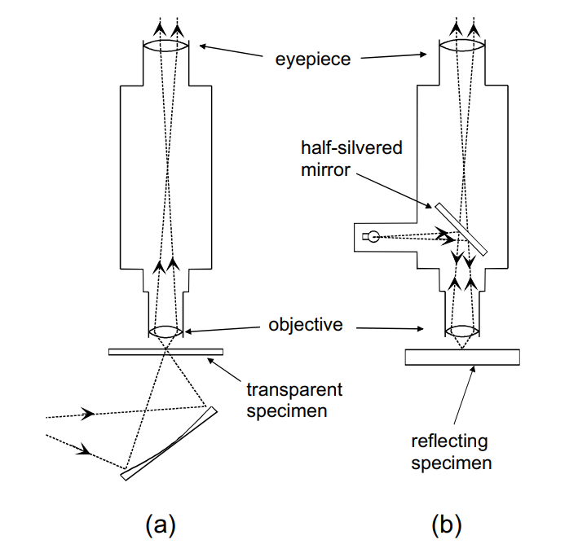
Simple optical microscope
Objective lens: collecting the light and focus before eye peace
Eye peace: focusing light on the eye
Transparant: light from below specimen
Opaque sample: light from the side, reflecting by 1 directional mirror
Notes:
Objectief: collecteert het licht, eye peace lens: focused weer op het oog

Slide 7
Magnification
Magnification is the ratio between the size of the real object to the size of the image
In optical microscopes, it is the product of eyepiece and objective magnifications

Slide 8
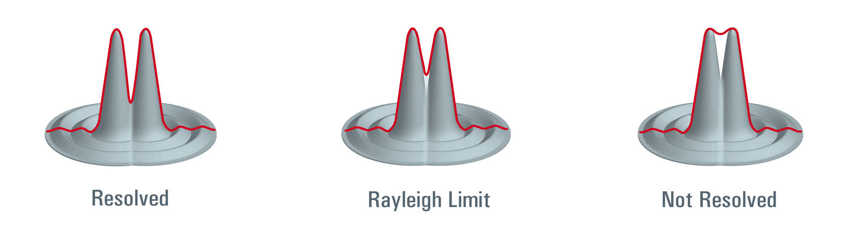
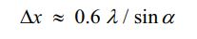
Resolution
Resolution is the amount of details you can see in an image
Image can be magnified using powerful lenses, but the blur will compound rendering images unrecognizable
Resolution is defined by the Rayleigh criterion: proportional to the wavelength of light used

Slide 9
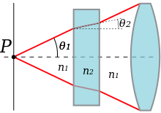
Numerical aperture (NA)
NA – range of angles a system can accept
NA = nsinθ < 1
NA =λ/пr
r is the radius where intensity is I₀e⁻²

Slide 10
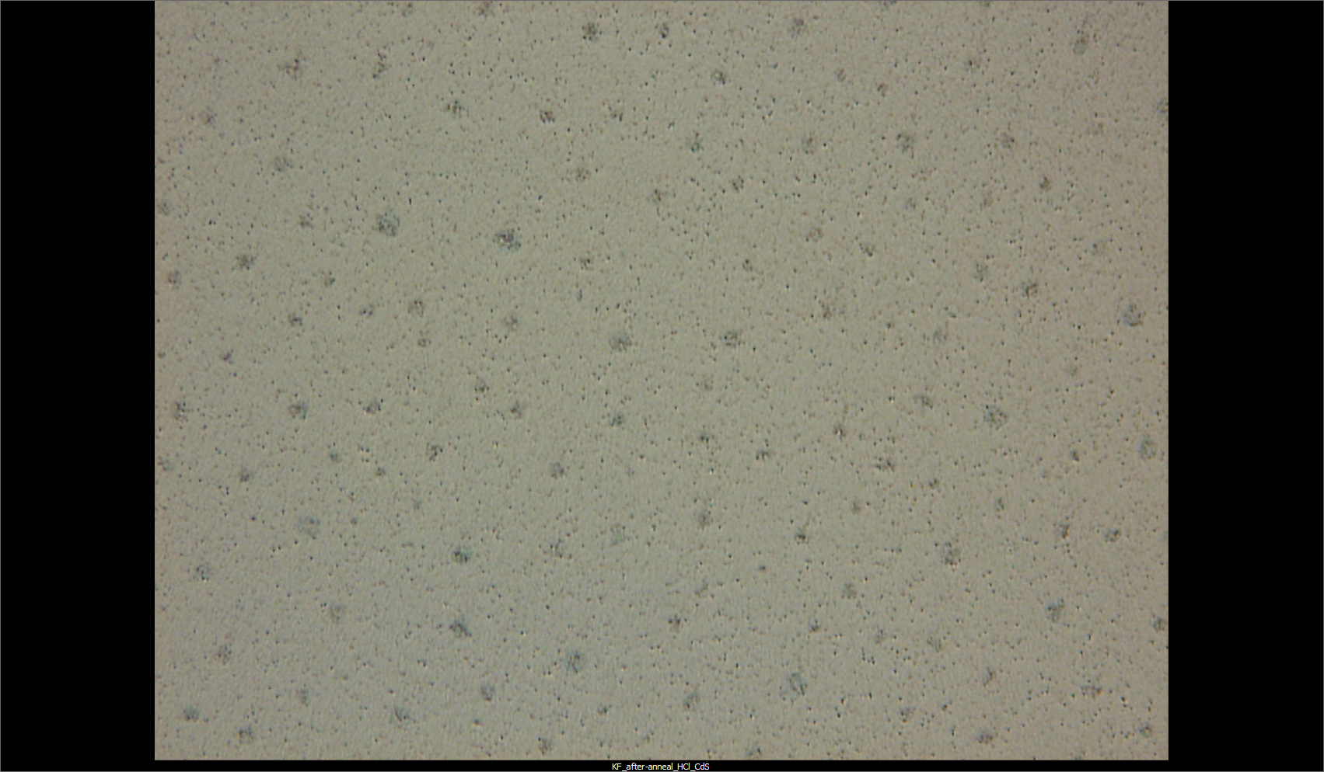
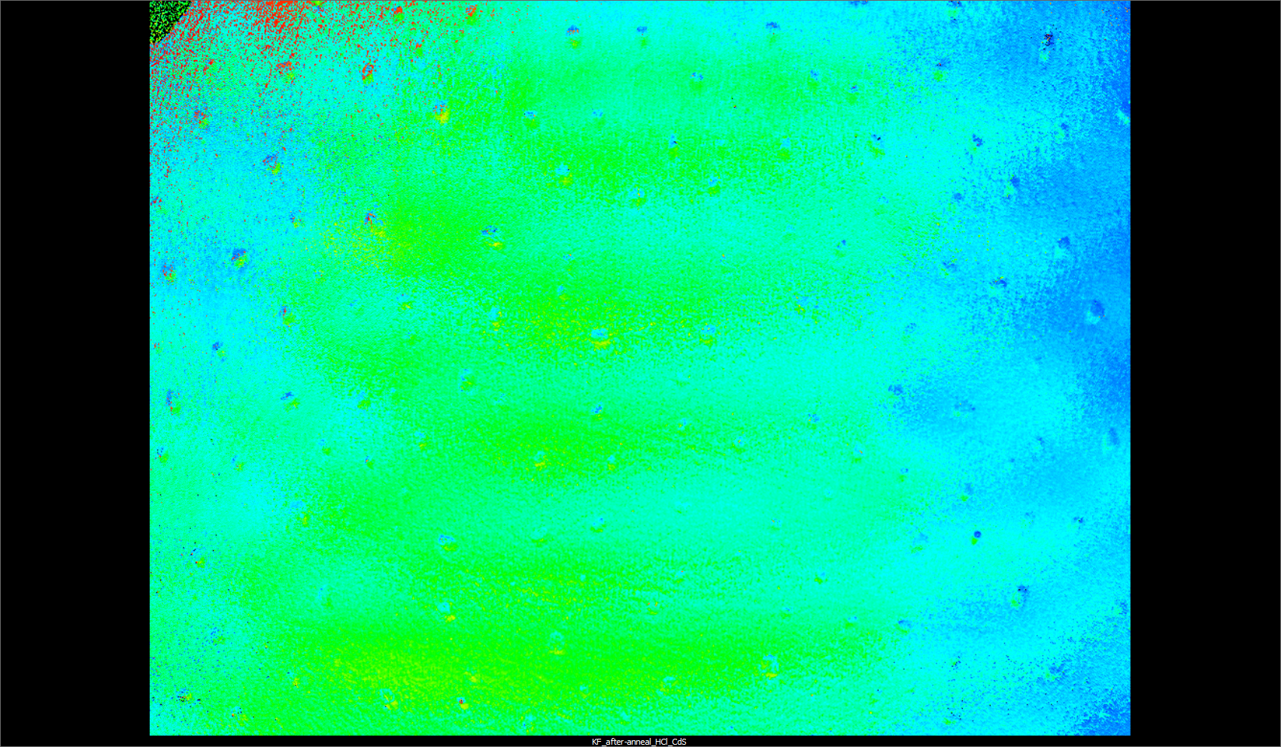
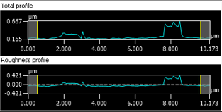
Confocal optical microscope

Slide 11
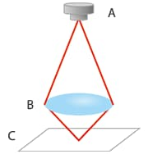
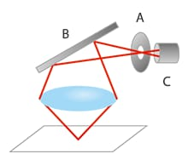
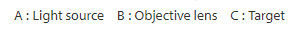

Confocal laser microscopy

Slide 12
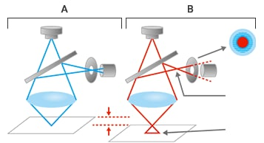
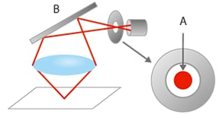


Confocal laser microscopy

Slide 13
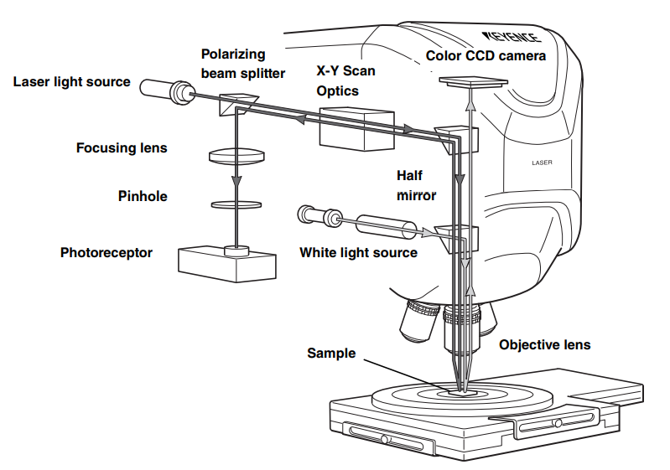
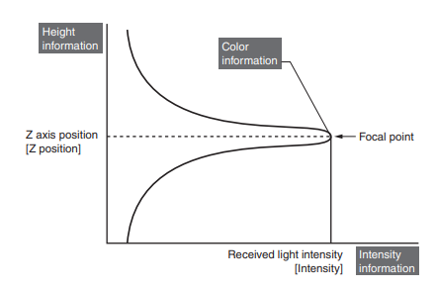
Confocal laser microscopy

Slide 14
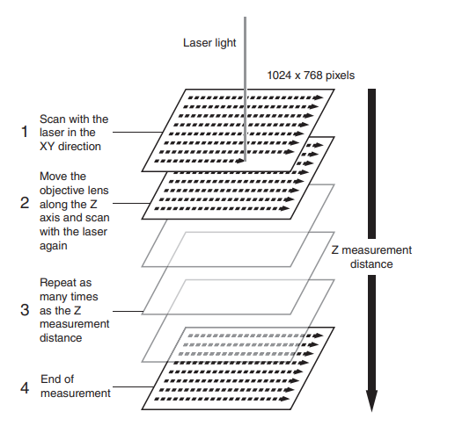
Confocal laser microscopy
XY step is determined by the spot size of the beam
NA depends on the magnification and wavelength of laser light (=658 nm)
Magnification | NA | Beam spot r (nm)
10X | 0.3 | 698
20X | 0.46 | 455
50X | 0.8 | 262
100X | 0.95 | 220

Slide 15
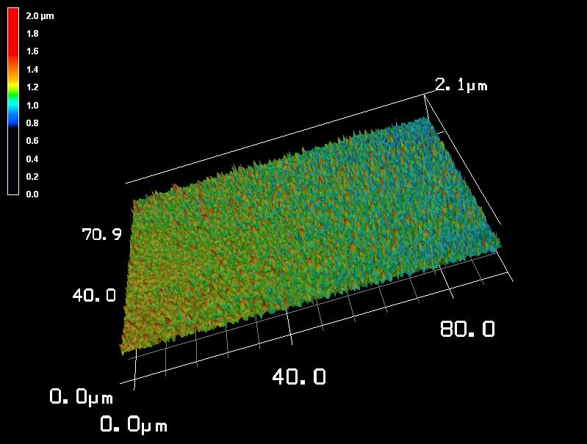
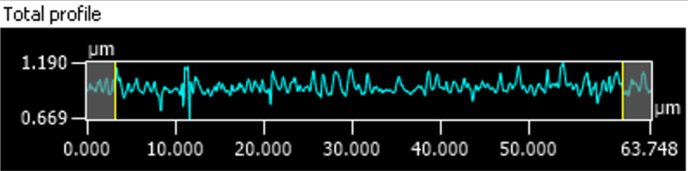
Confocal laser microscopy
XY resolution ~ 200 nm
Z resolution ~ 5 nm

Slide 16
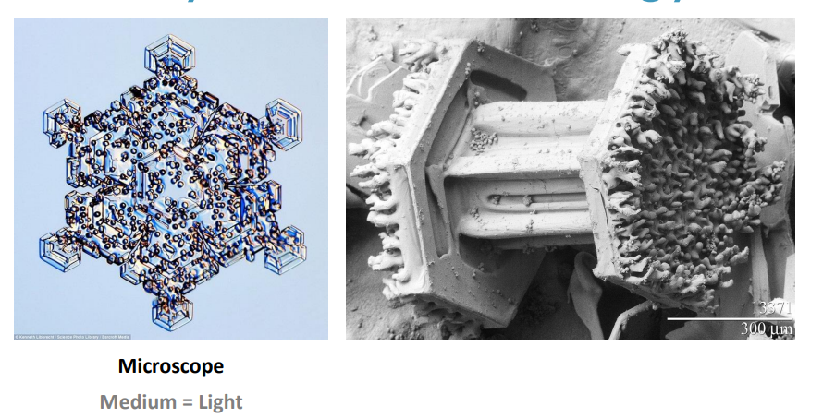

Medium
Photons (optical) or electrons
Tunneling
λ=400-700 nm
λ=0.001 nm

Slide 17
Electron microscopes
Electrons are used as illumination instead of light in optical microscopes
Electrostatic/electromagnetic lenses are used instead of optical lenses
Resolution in Angstrom (0.1 nm) range due to small wavelength of electron
Wavelength of electron ~ pm =10⁻³ nm (light is ~10²-10³ nm)
NA of electron microscopes ~ 0.01
NA = λ/пr → r ~ 0.1 nm

Slide 18
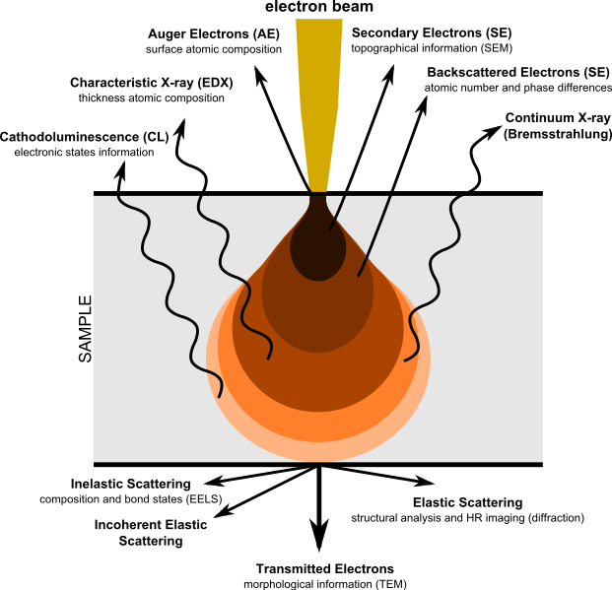
Imaging using electron microscopes
Electron beam is “shone” upon a sample, resulting in various beams
Secondary electrons and back-scattered electrons are used in SEM imaging
Transmission electrons are used in TEM imaging
EDX and EELS give information of the elemental composition

Slide 19
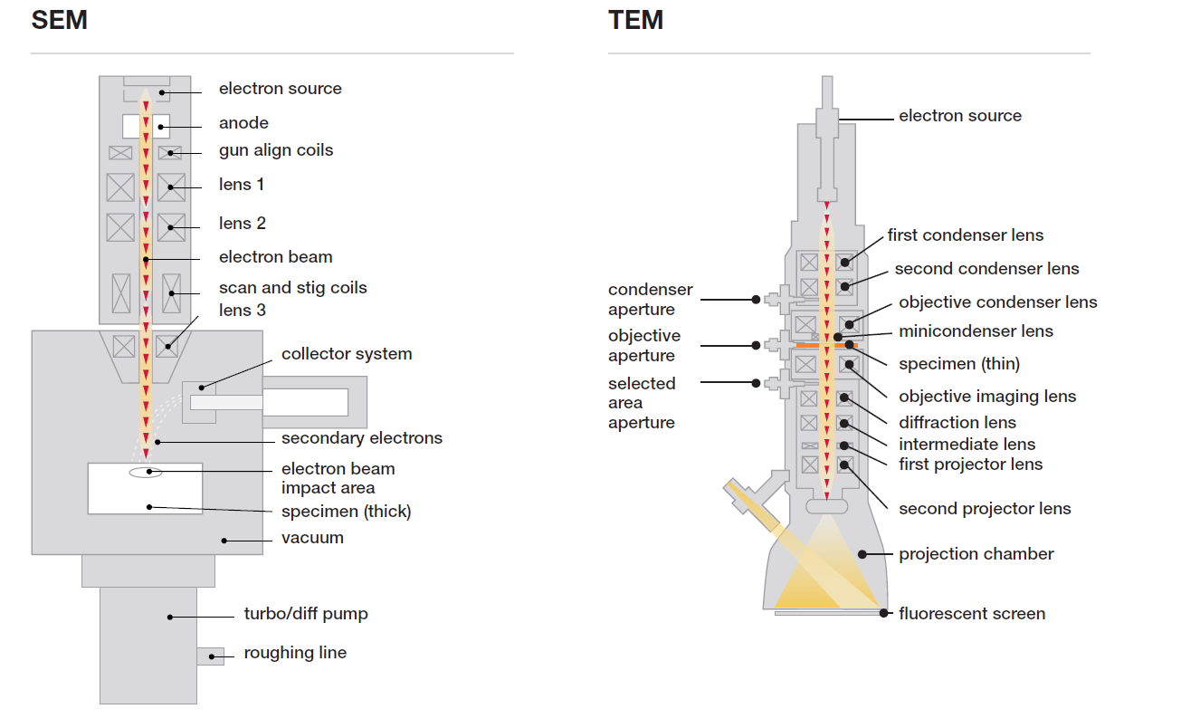
Electron microscopy

Slide 20
Electron microscopy
Transmission electron microscope
-broad electron beam hit the samples and electrons travel through a thin sample ( < 100 nm thin)
-electron react with the sample, loose energy are scattered, depending on the material
- electron intensity varies depending on position
-diffraction of electrons due to crystalline structure
-information about the bulk of the sample
-2D image

Slide 21
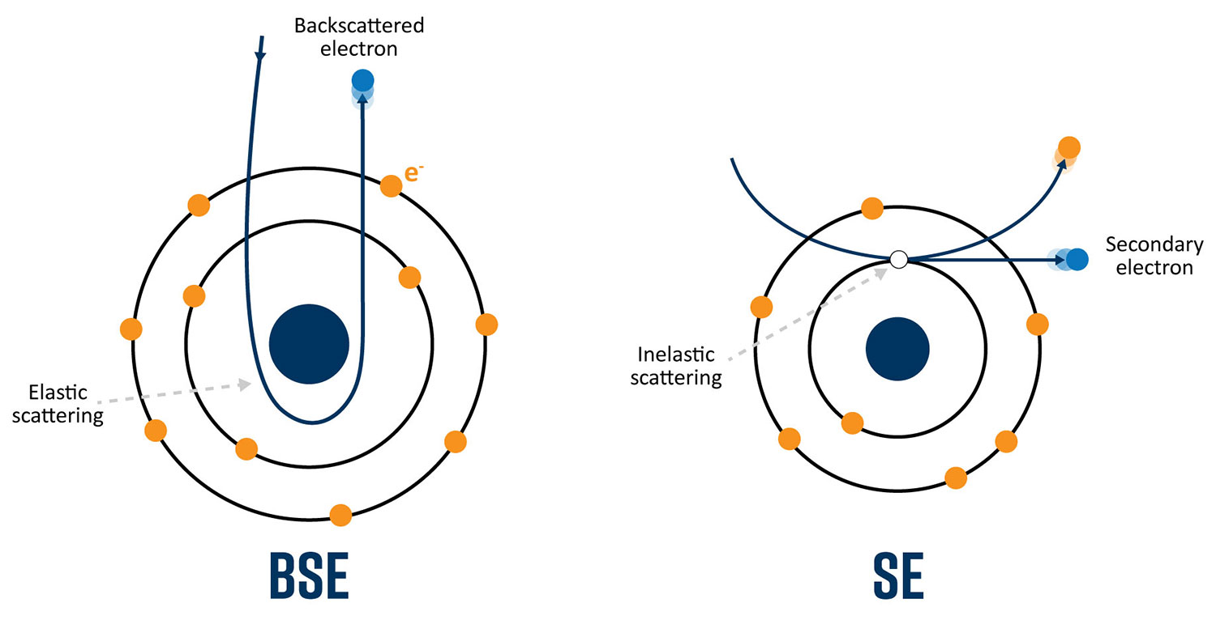
Electron microscopy
Scanning electron microscope
-focussed electron beam is scanned over the surface
-secondary electrons reflected from the surface (first few nm) are collected
-back scattered electrons from deeper in the material
-information from the surface of the sample
-3D image

Slide 22
Electron microscopy
Detector
Electrons need to be detected
Detection depends on the energy of the electrons
Secondary electrons – low energy
Primary electrons (from the beam) – high energy
Scattered electrons or in view of plane (dark field, bright field)
Various types of detectors
Semiconductor detectors
Scintillator → conversion of electrons to electromagnetic radiations

Slide 23
Electron microscopy
SEM vs TEM
SEM: surface, easy to use, little substrate handling, 3D images
TEM: internal structure, thin samples required, complex handing of substrate, higher resolution, 2D images
Both use a high energy electron beam → emission of X-ray

Slide 24
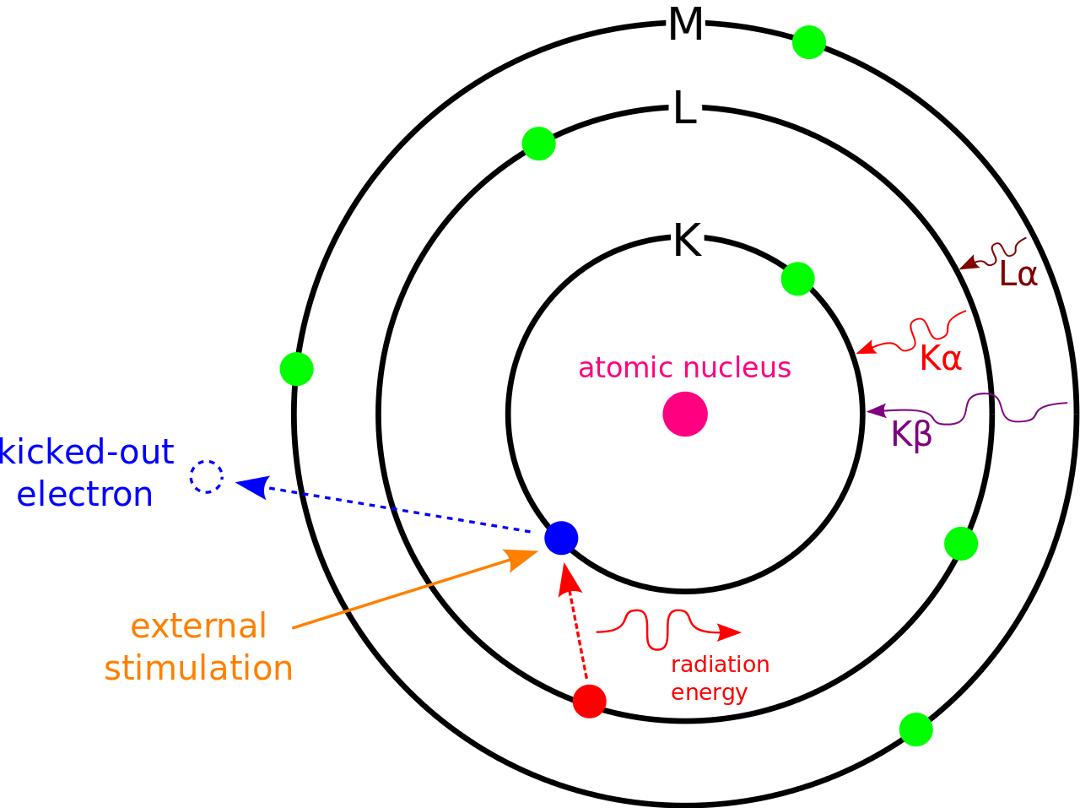
Energy dispersive X-ray spectroscopy
High energy electron beam (external simulation) kick valence electrons out their shell
Out electron fall back to the empty ground state, emitting X-rays

Slide 25
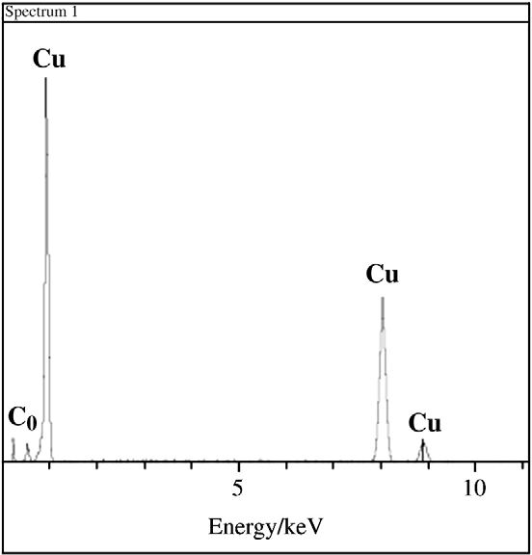
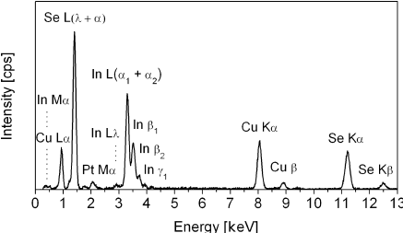
Energy dispersive X-ray spectroscopy
Emitted X-rays are fingers prints of the elements

Slide 26
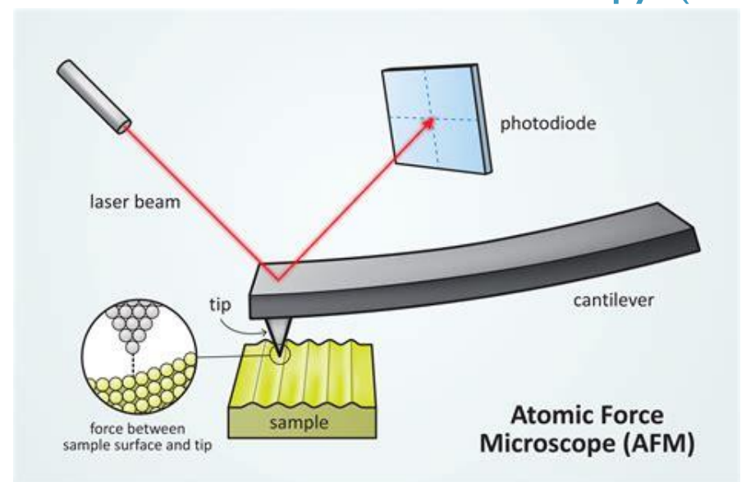
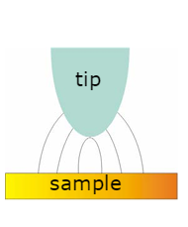
Atomic Force Microscope
Creates images of surfaces using a physical nanometer-sized probe
Probe is scanned over the surface
Sample – probe interaction is measured as a function of location
Resolution is limited by probe-sample interaction volume

Slide 27
Atomic Force microscope
Probe is scanned over the surface by oscillating the cantilever
Repulsive forces in play
Changes in the oscillation amplitude makes the controller move the piezo up or down to get the same oscillation back

Slide 28
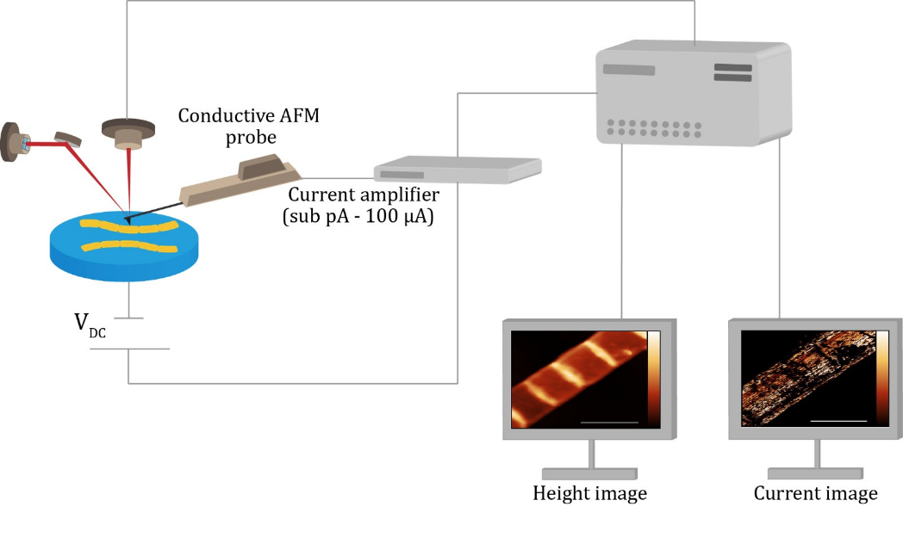
Conductive atomic force microscope

Slide 29
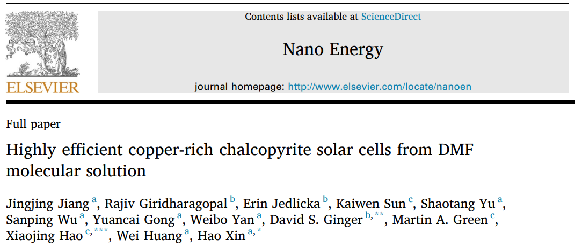

Slide 30
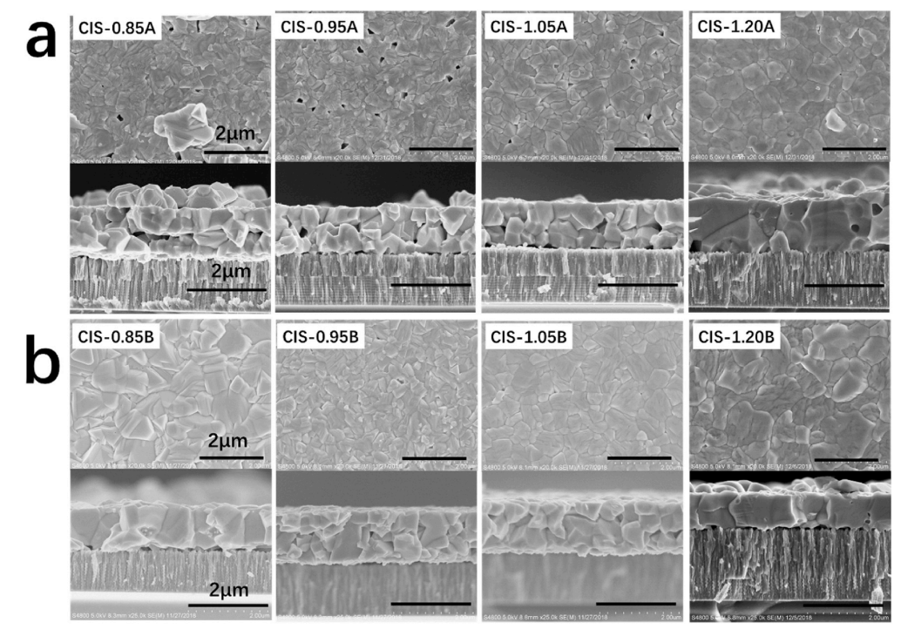
Scanning electron microscopy
SEM top view and cross section of CIS layers
SEM images reveal different grain size and pinholes depending on annealing conditions (A or B) and composition

Slide 31
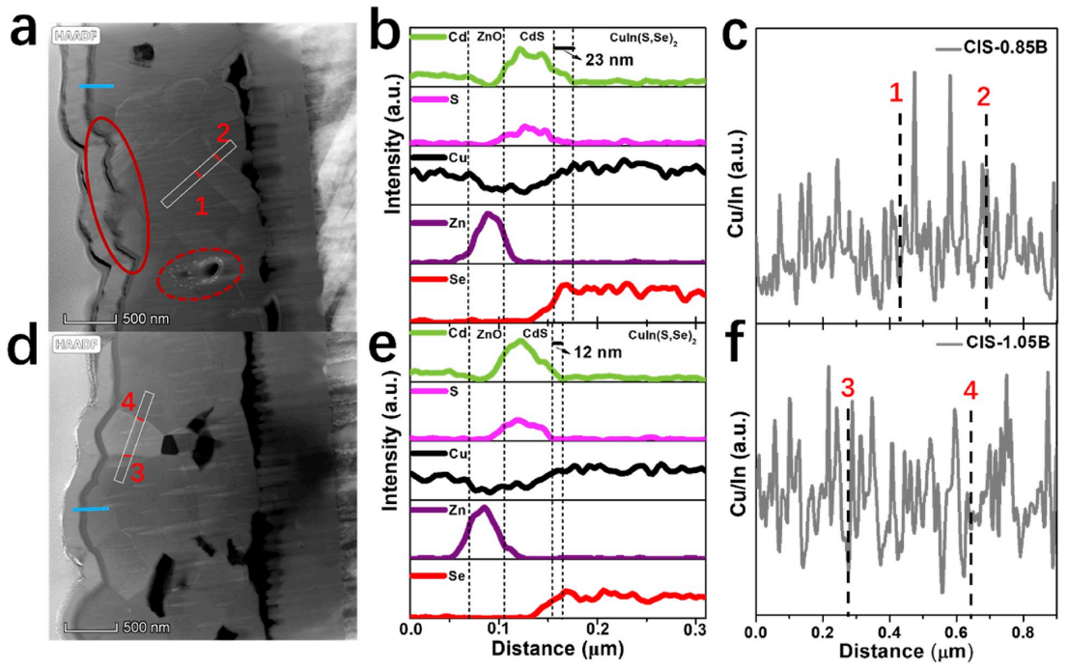
Transmission electron microscopy
Elemental analysis: energy dispersive X-ray
Color contrast due to material density variations
TCO
CdS
CIS
Mo

Slide 32
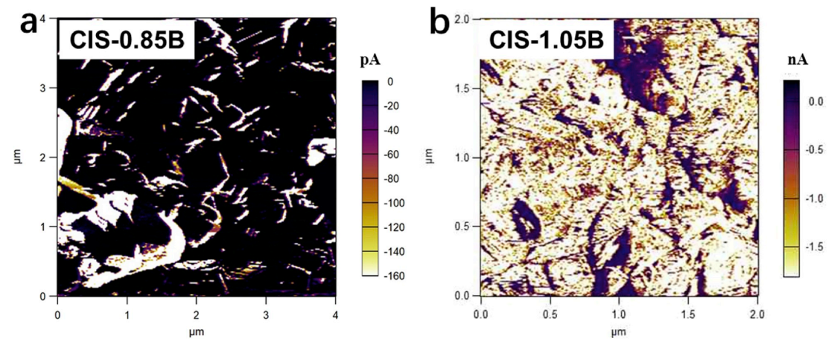
Atomic force microscopy
Conductive AFM: morphology and electrical conductivity
Electrical signal scanned laterally over the sample

Slide 33
Take away messages
Magnification and resolution: few 100s nm for optical microscopy, >1 nm for electron microscopy
Depending on the resolution and information required, choice can be made → handling of samples, price of systems, resolution required
Examples of various electron-microscopy techniques are presented, revealing the kind of information that can be obtained per technique (paper)

Slide 34


Notes:
Take away massages: 2 different technologies: thin film and Si, Si: thick robust, highly efficient, reached its limit: thin film –new, more options, less efficient but faster and cheaper to make. Can be combined with SI in tandem technologie, can be flexible, semi-transparent. What is an absorber layer, what is a TCO, why do we need light absorption etc

